Slide 1

Facial Expression Recognition from Live Video Stream using CNN
Group-8
1. Md Kaykobad Reza
2. Shahriar M Sakib

Slide 2

Motivation/Background
Recognizing and understanding human emotions plays a crucial role in various domains, such as psychology, human-computer interaction, and marketing.
Facial expressions are a rich and universal form of non-verbal communication, reflecting a person's emotional state.
Deep learning and CNNs have shown promise in image recognition tasks, making them suitable for facial expression recognition.
Our project aims to develop a real-time facial expression recognition system using CNN models with potential applications in emotion-based marketing, and psychological research

Slide 3
Problem Formulation
The project focuses on recognizing emotions from facial expressions in real-time scenarios.
To tackle this problem of emotion recognition, VGG16, and a customized 3-layer CNN are explored.
Augmentation techniques are employed to enhance the performance of the models. These techniques introduce variations in the images, improving the models' ability to generalize to different facial expressions.
The main objective is to identify the best performing model among the explored architectures based on accuracy .
The optimal model is further utilized to detect emotions from live video streams using OpenCV & webcam. This application demonstrates the practical use of the developed model in real-world scenarios

Slide 4
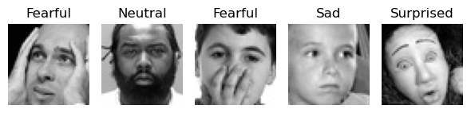
Dataset Description:
The project utilizes the FER 2013 dataset, which consists of grayscale images of faces. Each image is sized at 48x48 pixels.
The training set consists of 28,709 examples, while the public test set contains 3,589 examples.
The dataset includes seven emotion categories for classification: Angry (0), Disgust (1), Fear (2), Happy (3), Sad (4), Surprise (5), and Neutral (6).

Slide 5
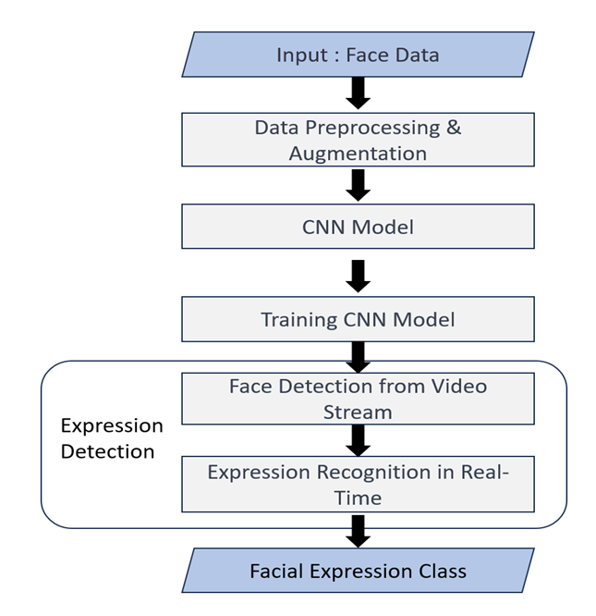
Work-Flow:

Slide 6
Data Preprocessing & Augmentation:
Normalization: To ensure consistent and standardized input, the face data was normalized between the range of 0 to 1.
Augmentation strategy: Horizontal and vertical shifts, horizontal and vertical flips, and rotation are used to introduce variations in the images. We also tried Mixup and Standard augmentation while performing contrastive learning.

Slide 7
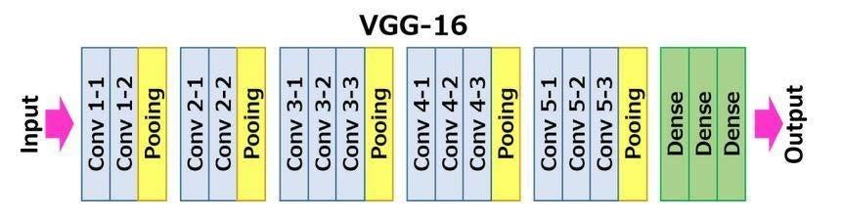
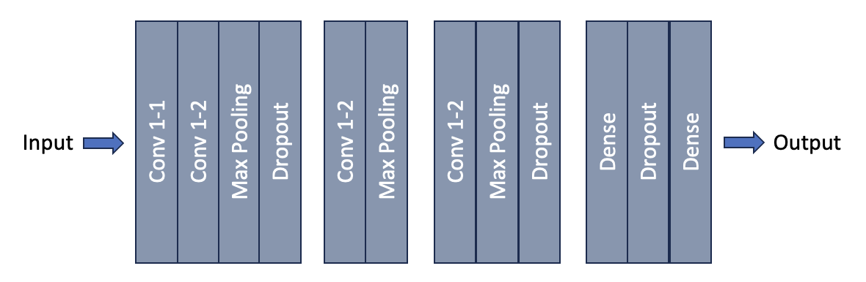
CNN-Models:
The project explores VGG16, and a customized 3-layer CNN model
VGG-16
Customized 3-Layer CNN Model

Slide 8
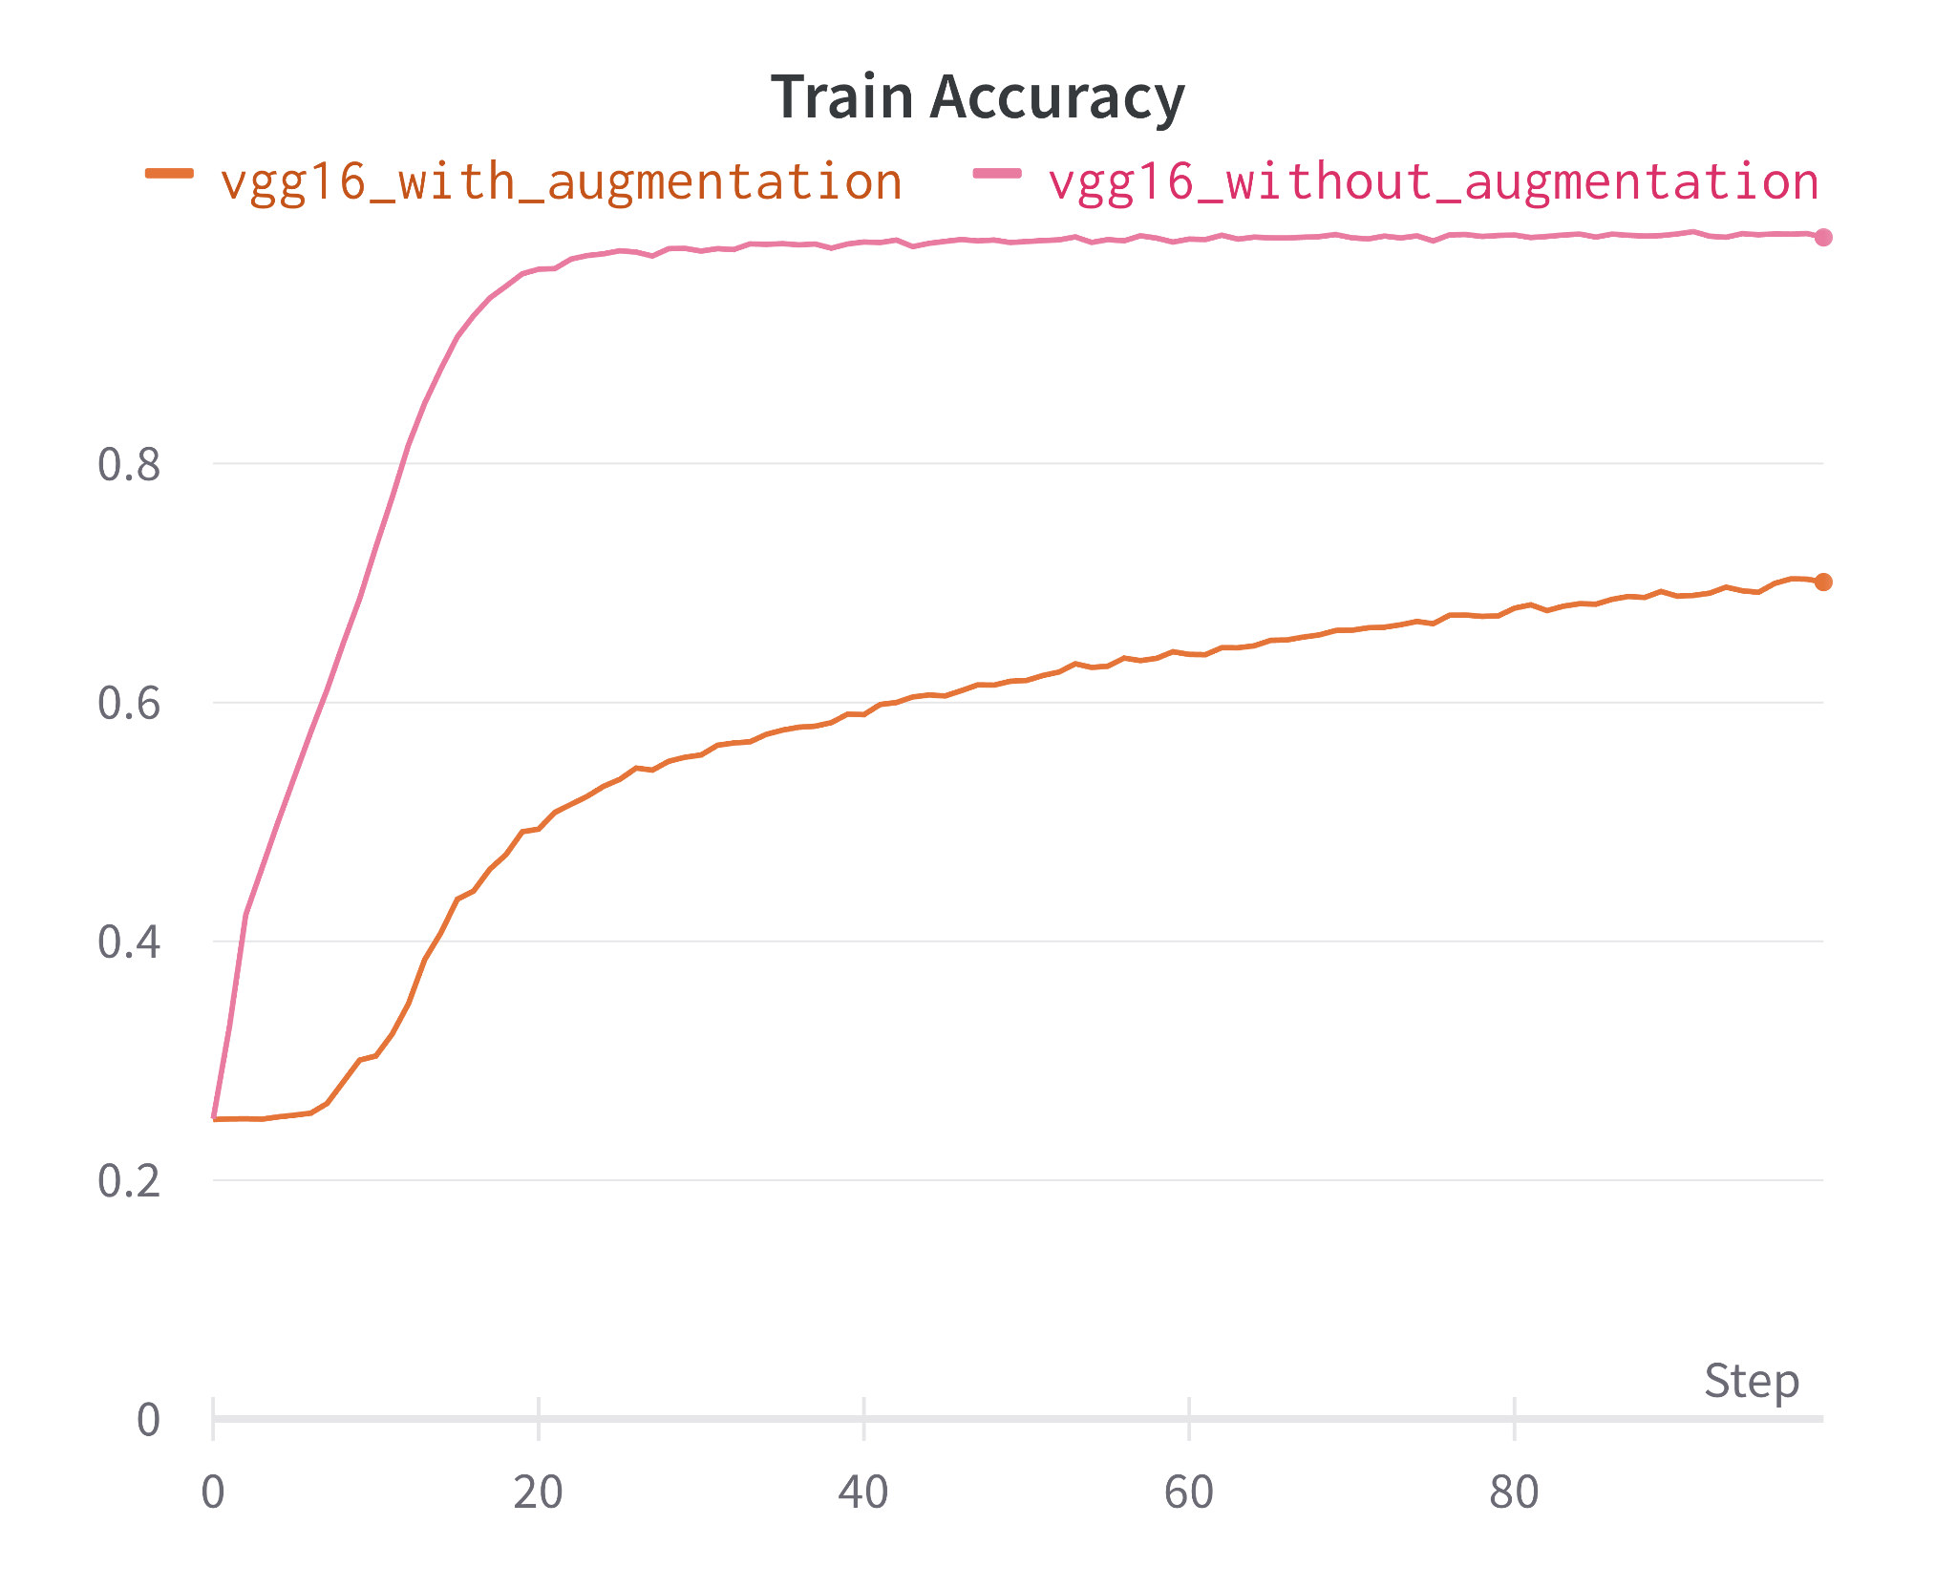
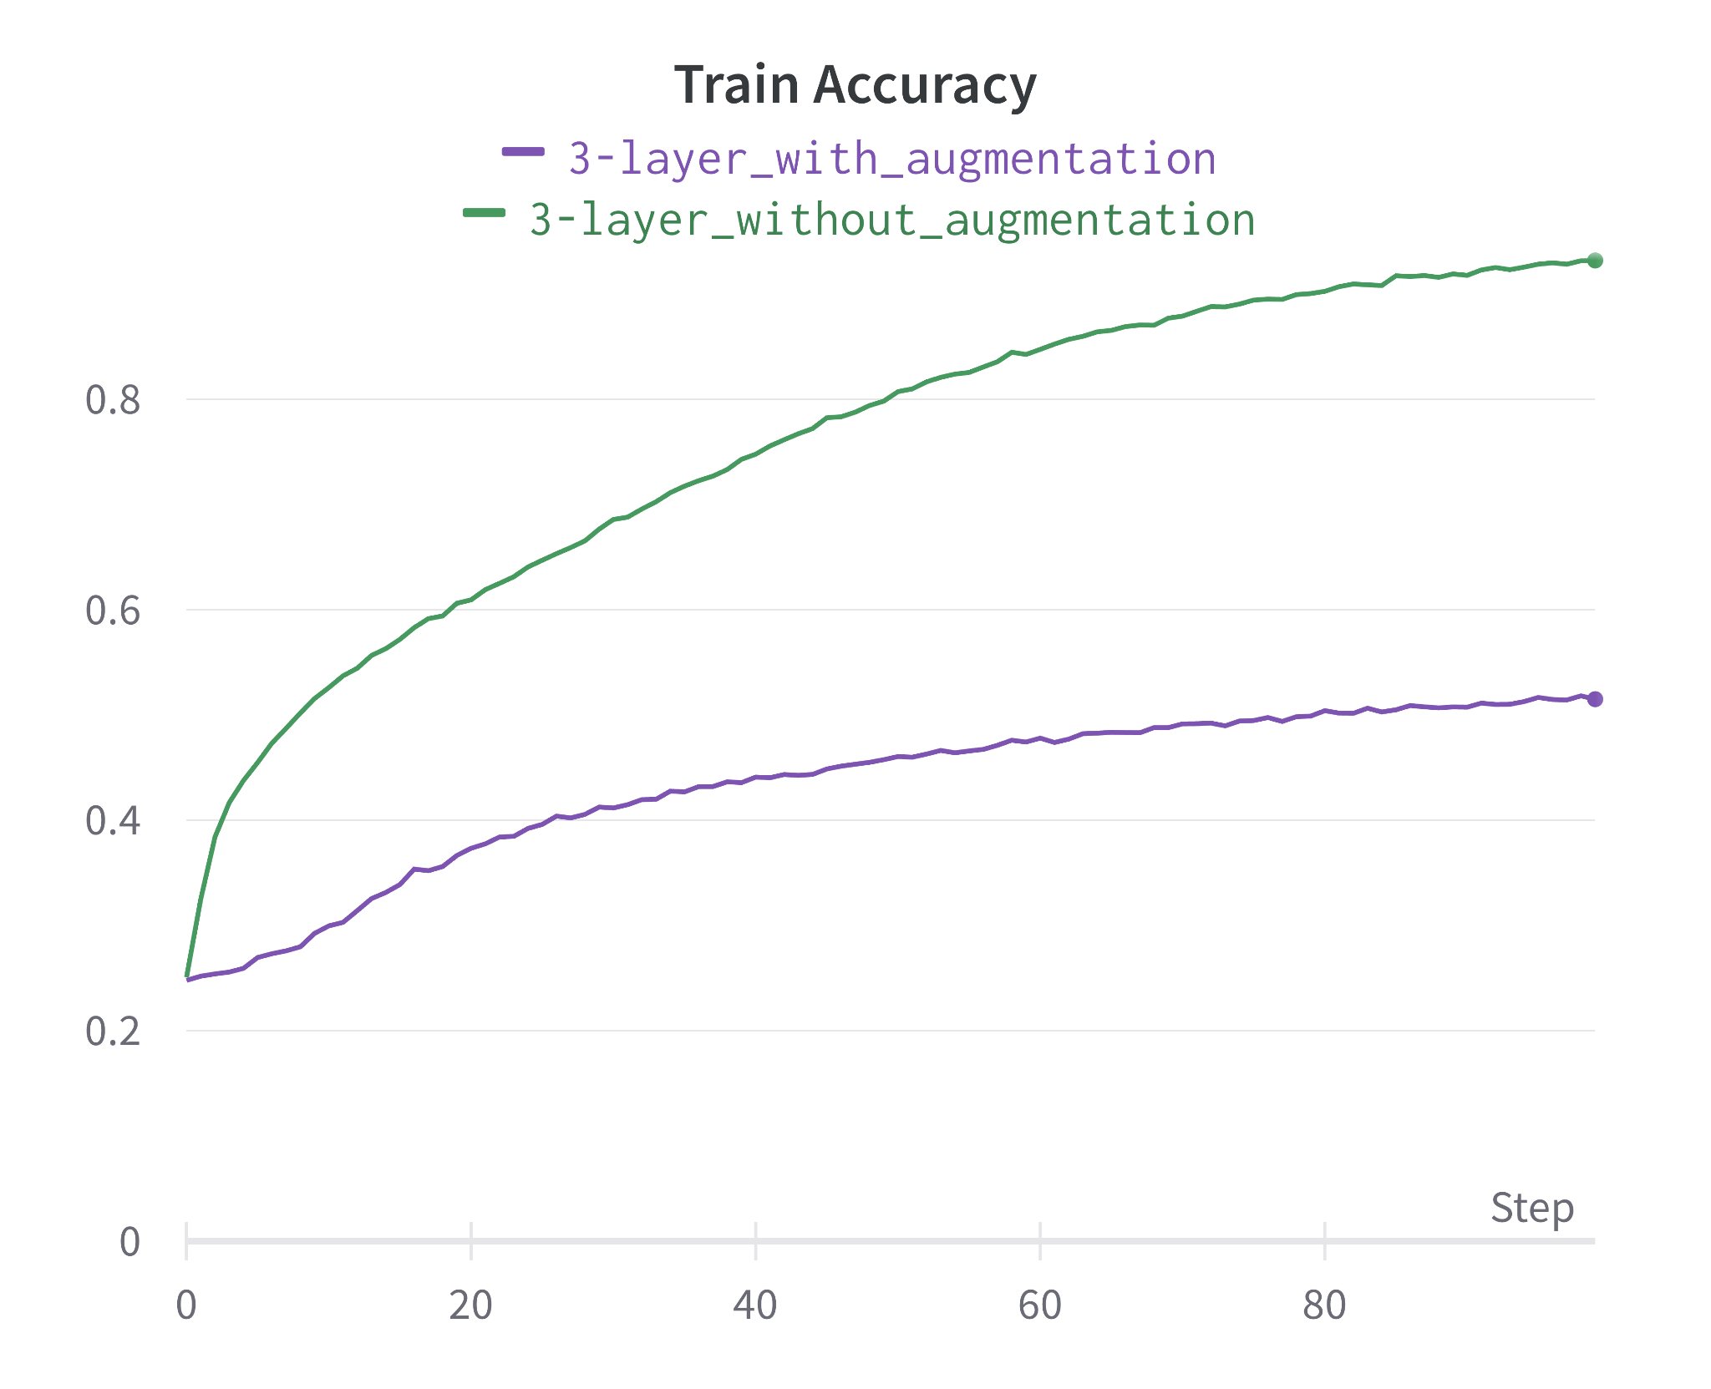
Model Comparison:

Slide 9
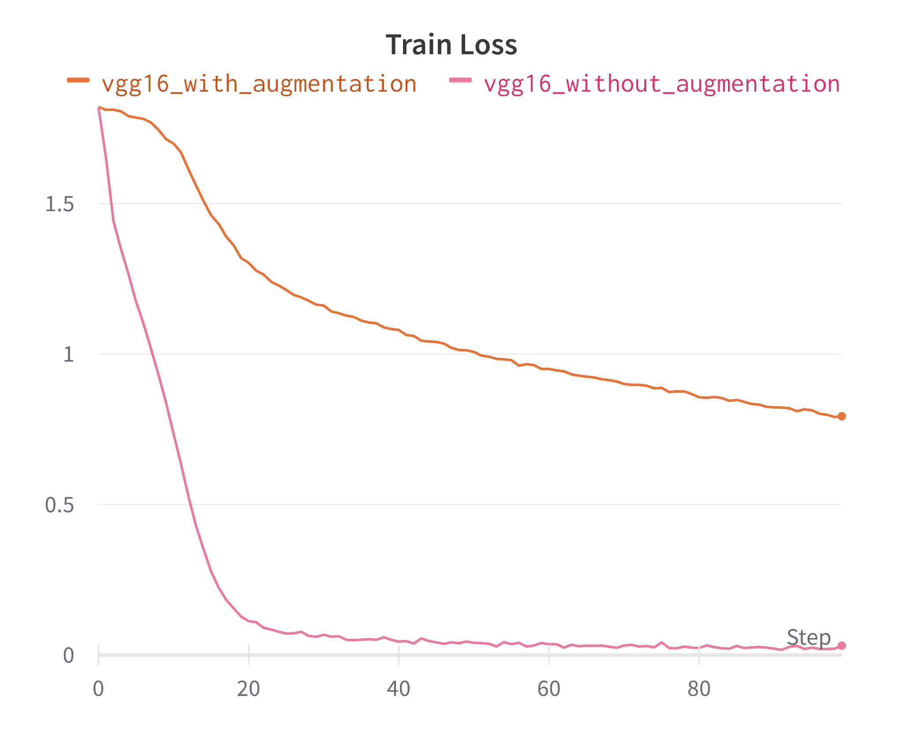
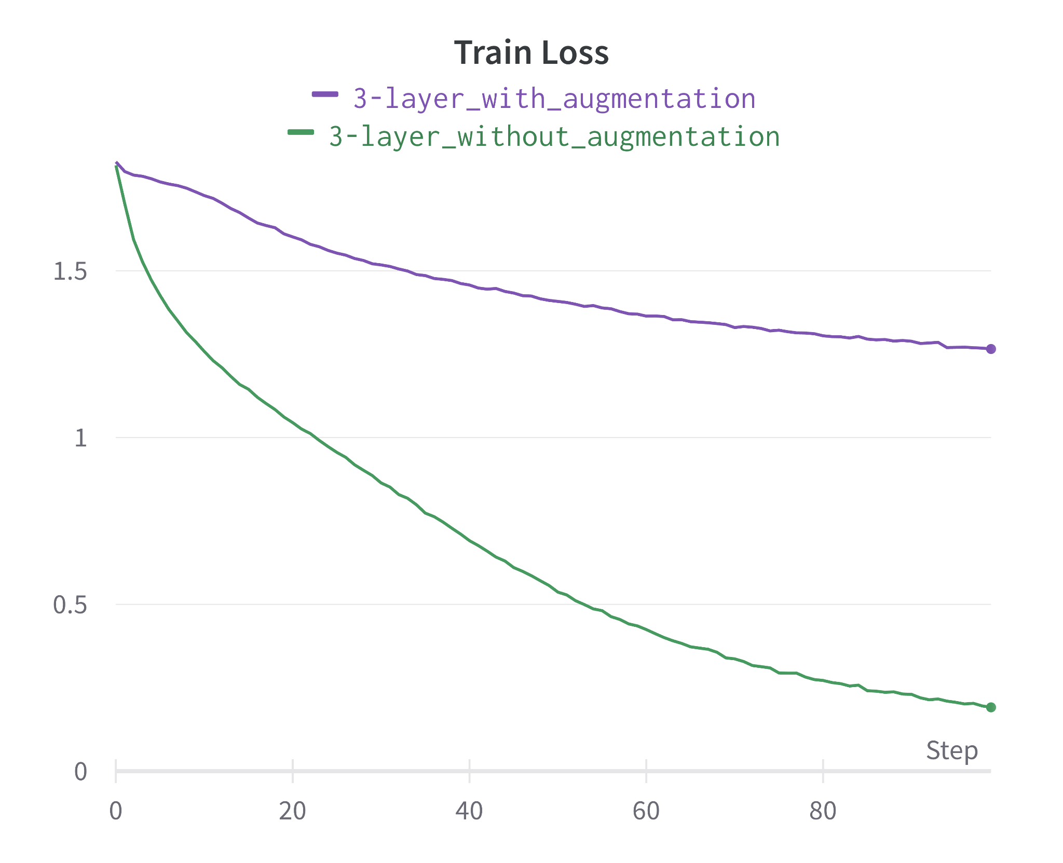
Model Comparison:

Slide 10
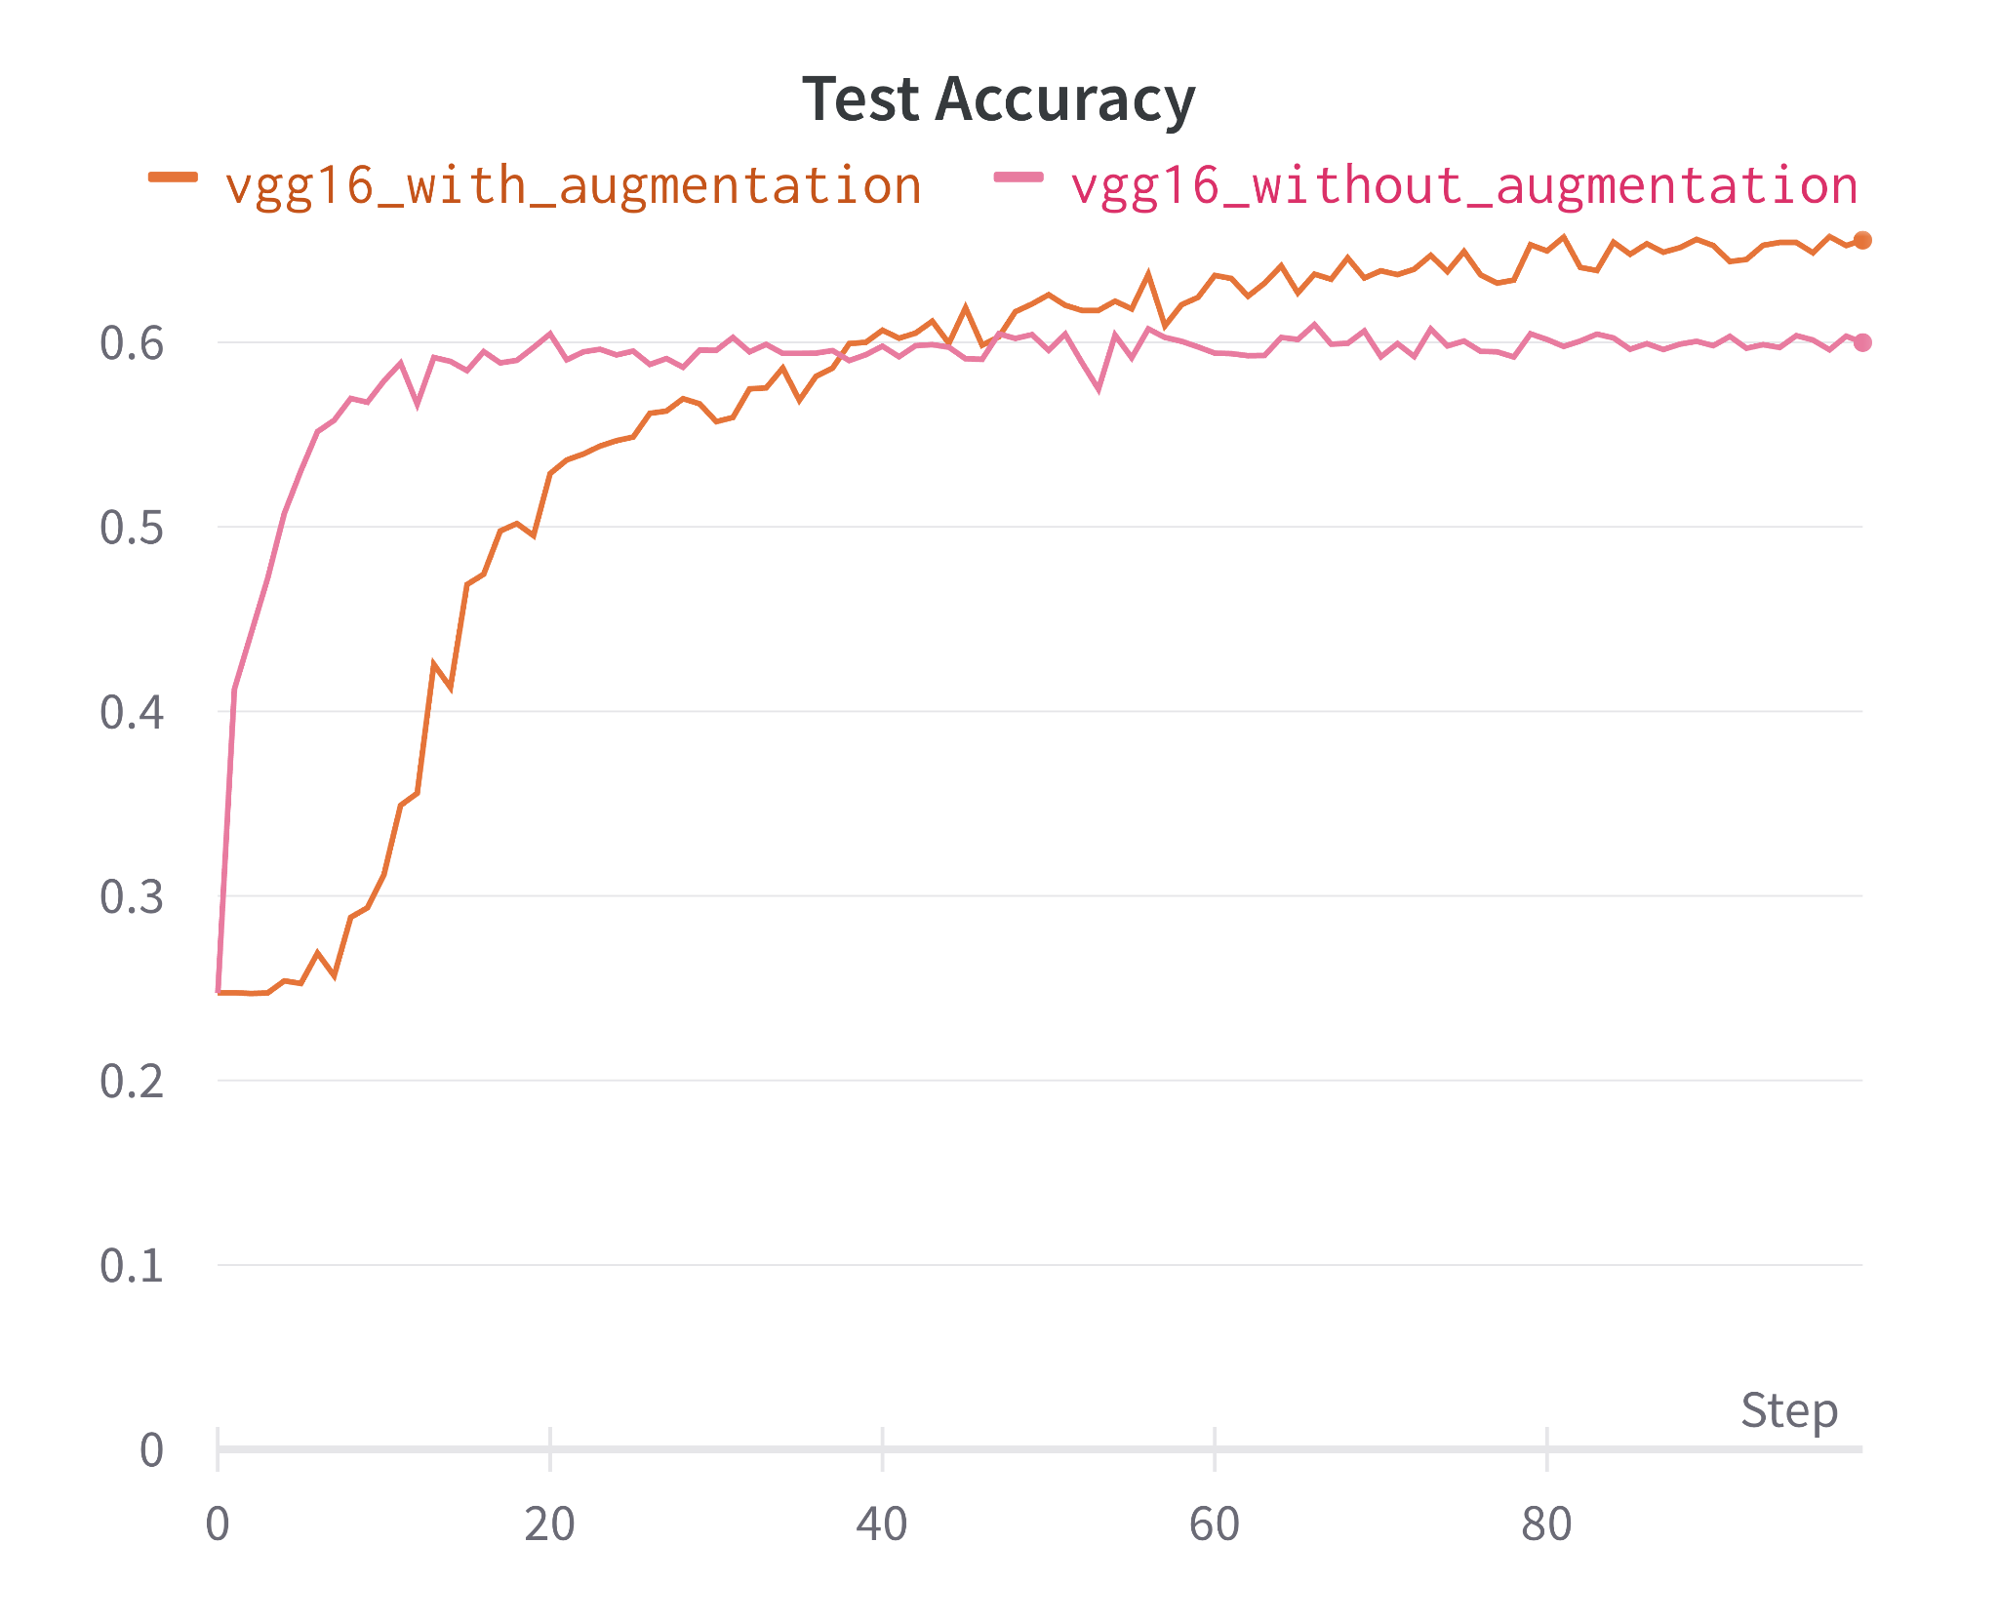
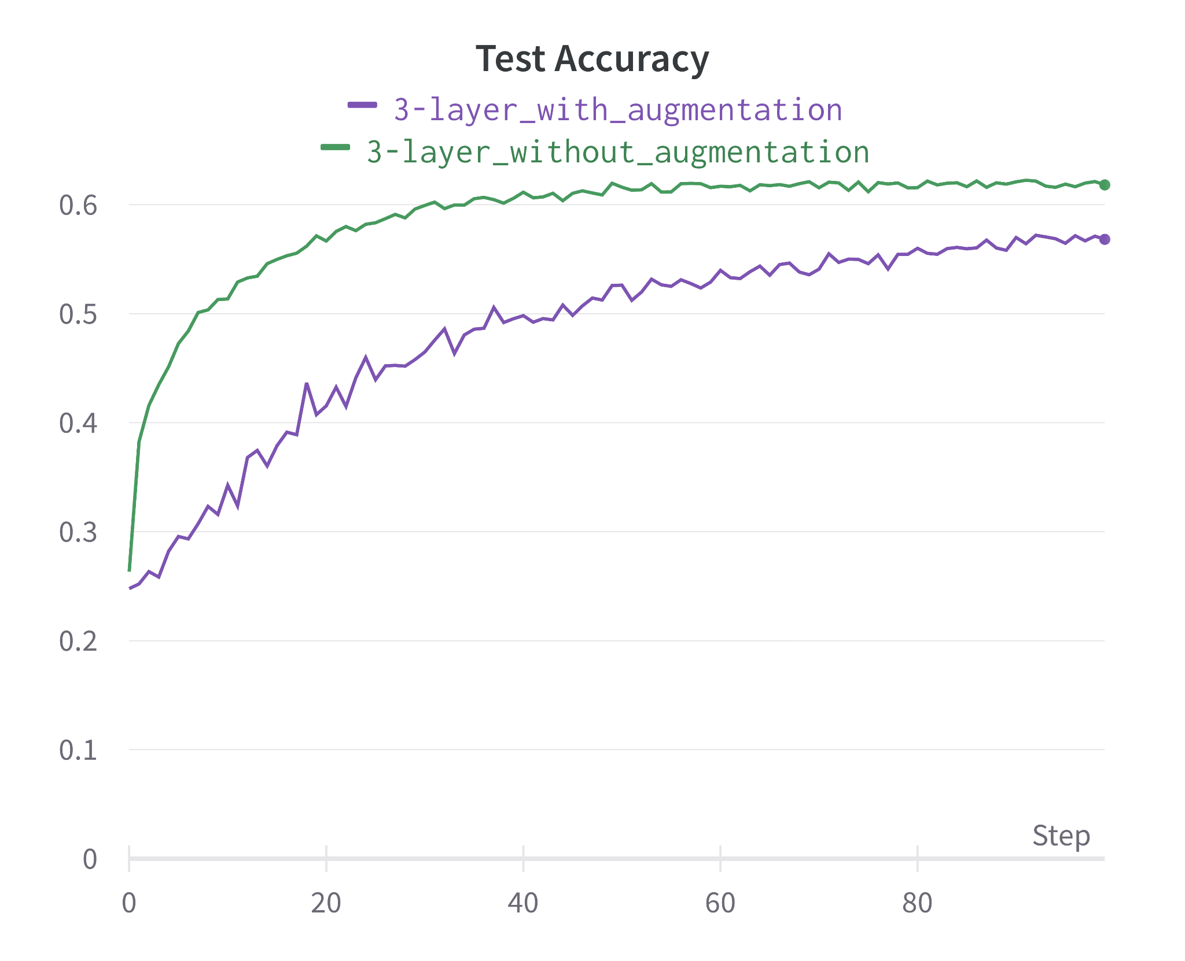
Model Comparison:

Slide 11
Model Comparison:
Model Name | Test Accuracy (Without Augmentation, %) | Test Accuracy (With Augmentation, %)
3-Layer CNN Model | 62.25 | 57.20
VGG-16 | 60.97 | 65.74

Slide 12
Expression Recognition in Real-Time:
As VGG16 model with data augmentation performs best, we utilized this model for real-time prediction of facial expressions.
First we captured live video stream from a webcam using OpenCV and Python.
Detected faces in each frame, crop the face and resized them to 48x48 grayscale images, matching the model's input requirements.
Model predicted a number representing an expression, which was mapped to the corresponding expression and displayed alongside a related emoji.

Slide 13
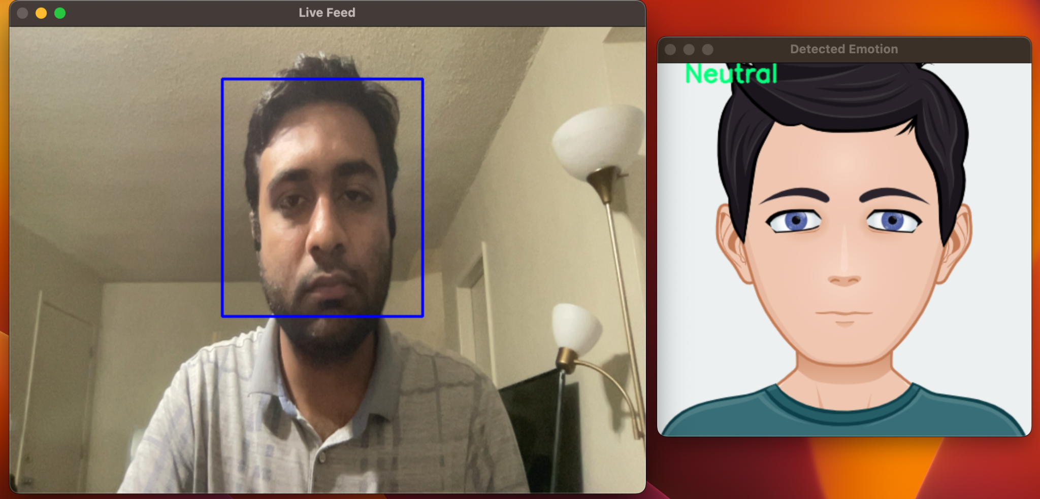
Expression Recognition in Real-Time:

Slide 14
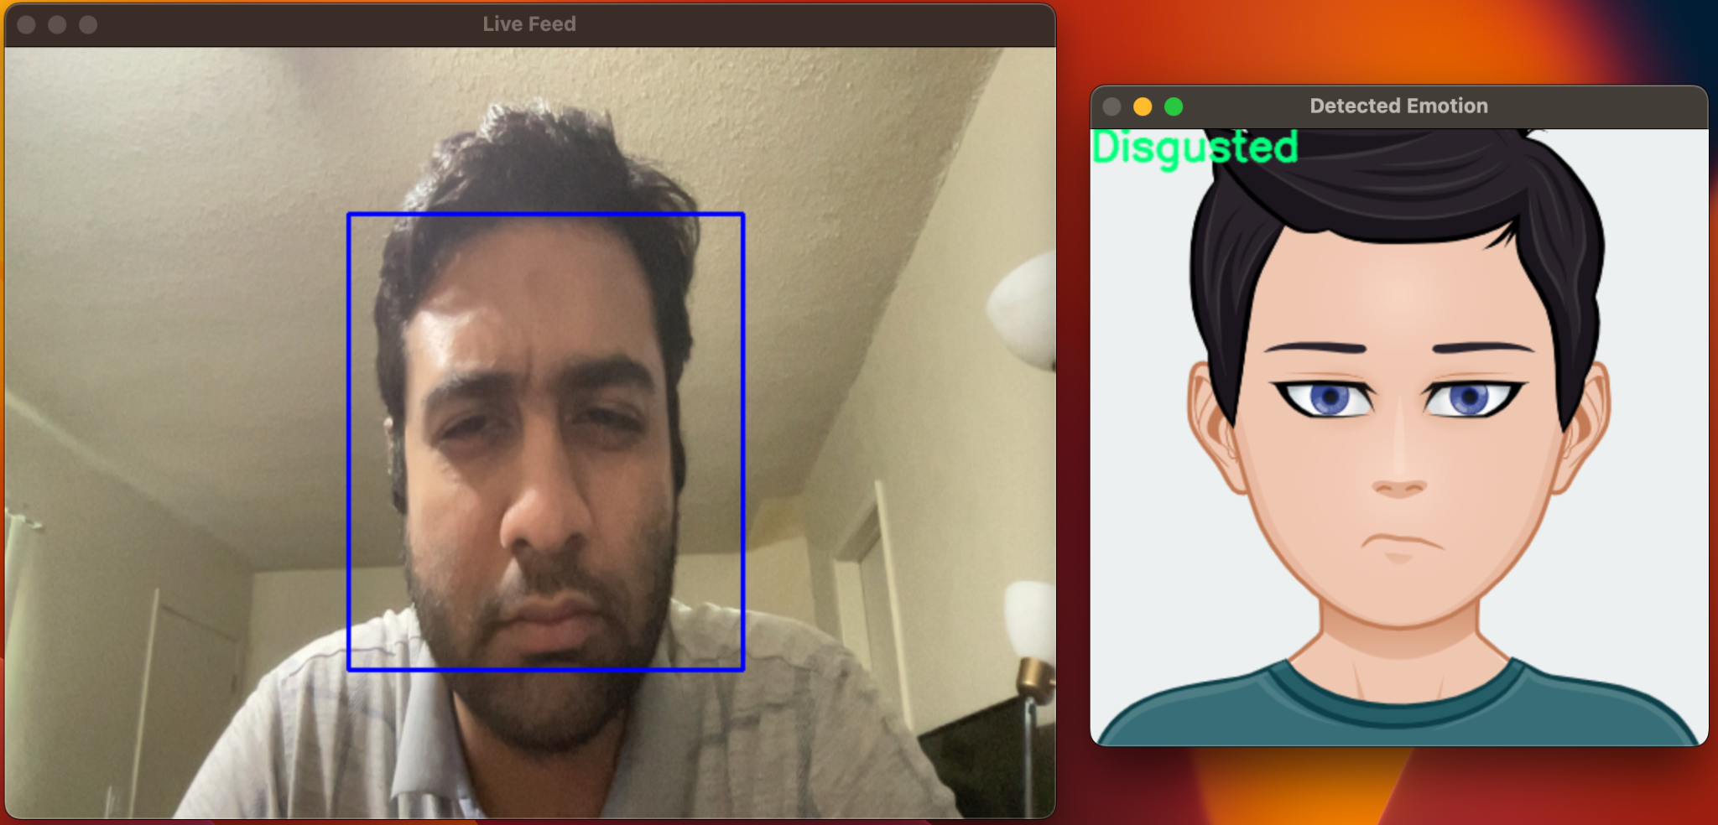
Expression Recognition in Real-Time:

Slide 15

Expression Recognition in Real-Time:

Slide 16
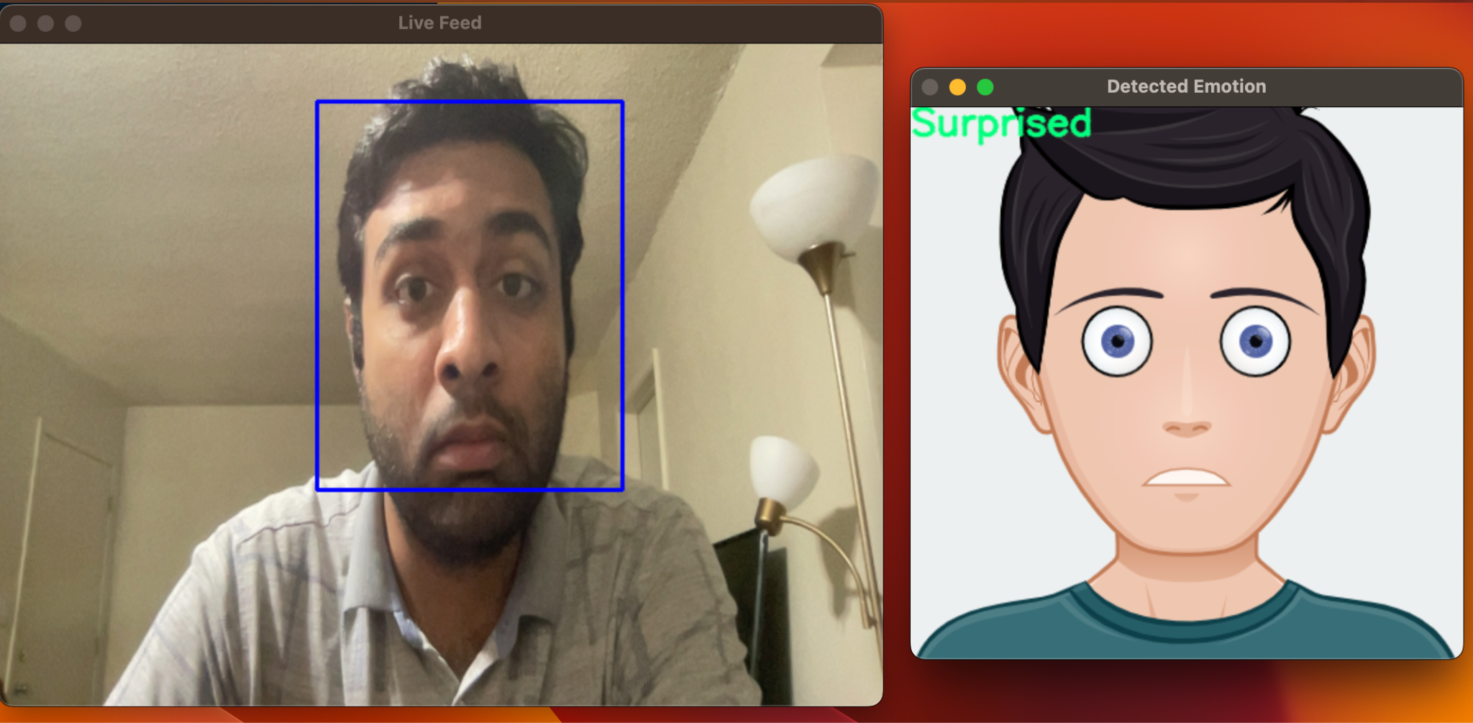
Expression Recognition in Real-Time:

Slide 17

Expression Recognition in Real-Time:

Slide 18
Limitations and Future Directions:
Due to the limitation of computational resources, we could not train our models for a larger number of epochs. Given enough time, the model performance would have improved further.
Our main goal was to develop a real-time system, so our focus wasn't on achieving state-of-the-art performance. However, we could have further improved the system's performance by training on multiple datasets and incorporating multiple models through ensemble learning.
Training on larger datasets, more powerful models, different ensemble techniques while maintaining low resource utilization can be a good direction of future work.
Future works can also involve evaluating these kinds of systems in real world scenarios.

Slide 19
Questions?

